Slide 1
Gaining footing in shifting sands: An experiential approach to identifying and actualizing values in team settings
Sunday, June 19, 2022
10:45-12:15

Slide 2
Disclosures + disclaimers:
The presenters of this workshop have not received and will not receive any commercial support related to this presentation or the work presented in this presentation.
This presentation is based on work supported, in part, by the Department of Veterans Affairs and the Eastern Colorado Health Care System but does not necessarily represent the views of the Department of Veterans Affairs or the U.S. Government.

Slide 3
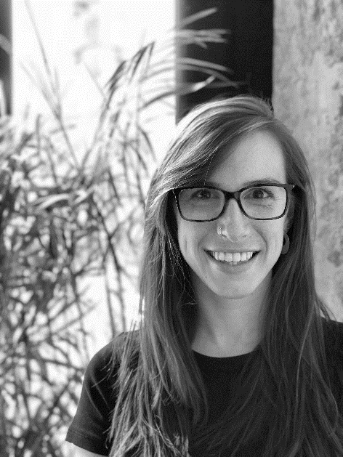
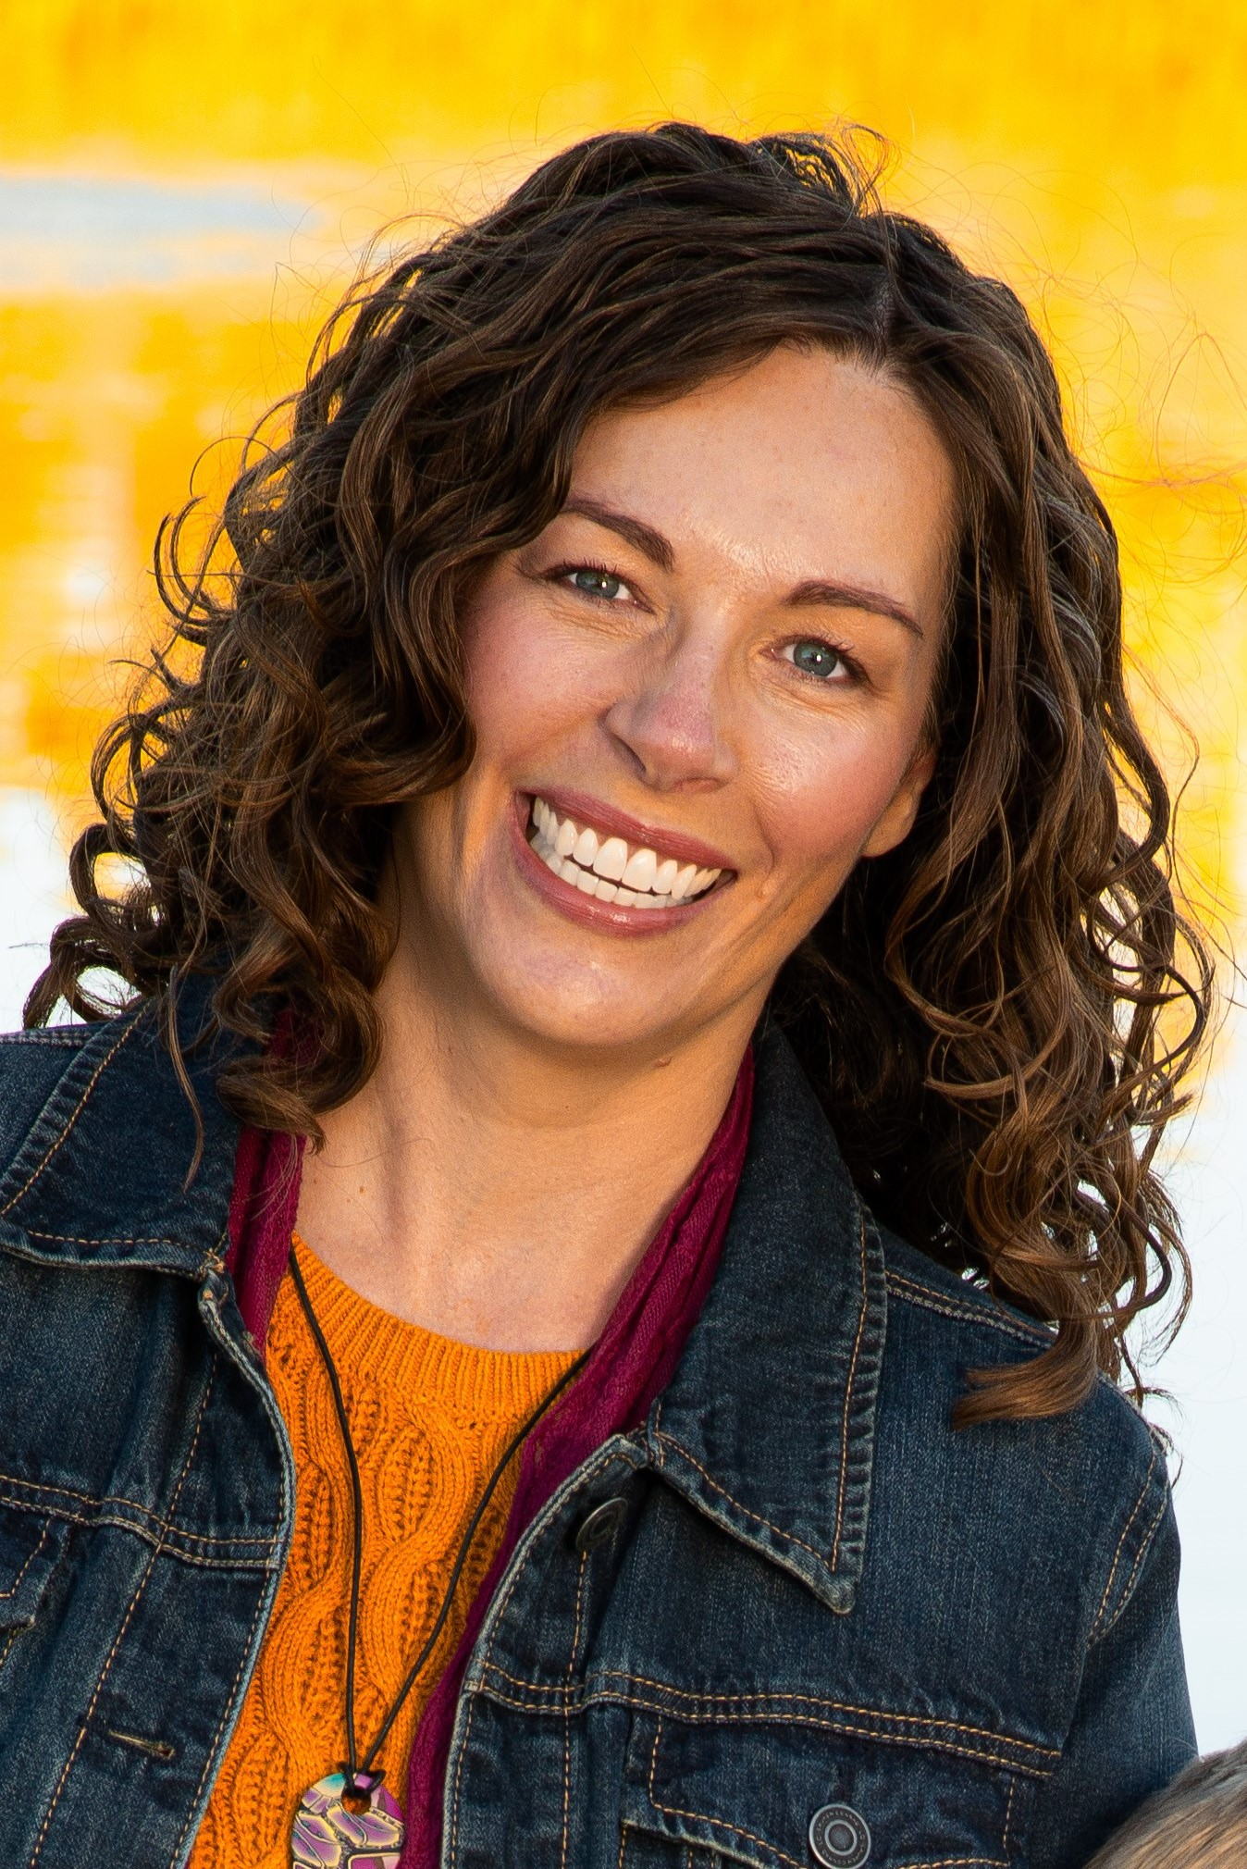
Dr. Lia Bishop
Lia Bishop, Ph.D.
Clinical Psychologist
VA Eastern Colorado Health Care System
“Ascend” PTSD Residential Rehabilitation Treatment Program
Lia.Bishop@va.gov
Mandy Rabenhorst, Ph.D.
Program Manager, Clinical Psychologist
VA Eastern Colorado Health Care System
“Ascend” PTSD Residential Rehabilitation Treatment Program Mandy.Rabenhorst-Bell@va.gov
Dr. Mandy Rabenhorst

Slide 4
Notes:
[Experiential Exercise Script]

Slide 5
“Professional Values”
Family
Professional
Social
Values
Different across domains?
Overlapping and expressed differently or similarly?
Notice which are activated or stifled in a professional context
Key question:
When are you out of your values? How do you know?
When are you in alignment with your values? How do you know?

Slide 6
Why identify and highlight professional values?
The past several years have led to an immediate and drastic change in many working environments:
Global pandemic
Racial and social justice movements
This has been a unique span of time because there was no opting out
Clearly see challenges in the organizations, systems, culture, and communities within which we work
Highlighted and exacerbated pain points

Slide 7
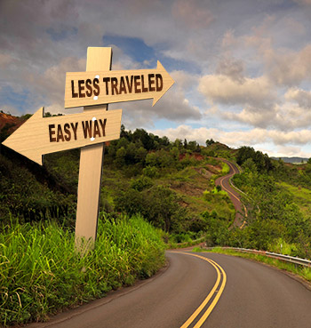

Slide 8
Notes:
Jen - “There were some I just couldn’t live without”

Slide 9
Mission Statement
specific
clear
Practical (not aspirational) tool
shaped by your values
Designed to
Ground you
Motivate you
Remind you of your professional passion and purpose
Helps guide decision-making
Helps contextualize tasks
attainable
inspiring
yours

Slide 10
Let’s make this concrete…
What?
Communicate your fundamental professional objectives
How do you define success?
What is your primary goal?
With whom?
Choose your target audience
Who do you hope your work impacts?
How would you like to do this?
Pull in those values!

Slide 11
…and get vulnerable
Mandy’s values:
Authenticity
Growth
Connection
“I will approach my professional work with authenticity. I will be genuine and true in my interactions with others and with myself to foster connection and growth, especially with those I lead.”
Lia’s values:
Creativity
Passion
Justice
“To help individuals and communities heal after trauma. My professional endeavors will channel creativity and passion to foster justice and meaning.”

Slide 12
Carry it home
Continue to refine and polish your mission statement
This is a living document!
Put a physical copy in frequently visited places (electronic and/or physical both work well)
Share with others

Slide 13
How do we keep working in this space?
What a leader brings into the room is what’s allowed in the room
If you’re not in a leadership role, then who’s your biggest ally? Who’s buy-in do you need to enact collective action?
Some strategies that we’ve used:
Conduct these exercises with your team
Start the conversation:
When are we most aligned with individual or shared values?
How can we actualize individual values in a team setting?
How can we keep values central in discussion and decisions?
How can we discuss intra-team conflict through a values-based lens?
Share accountability for check-ins and follow-ups

Slide 14
Resources
70 Best Personal Mission Statement Examples - Rigorous Themes
How To Write Vision and Mission Statements | Indeed.com

